Slide 1
“UNITY IN ROTARY SHOWCASE” SOLO CYCLING EVENT (5000 km) July 15, 2018 – Sep 02, 2018 Somnath Temple (Gujrat - India) to Pashupatinath Temple (Kathmandu – Nepal) Via Sikkim. To promote “Beti Bachao Beti Padao” & “Tree Plantation”
Cyclist:- Rtn. Sunita Singh Choken
An Initiative Of:- RI District 3011
Facilitated / Sponsored by:- Rotary Club of Rewari Main
DG:- Rtn. Vinay Bhatia | AG:- Rtn. Naveen Arora | President:- Rtn. Sunil Thakral
Hony. Secretary:- Rtn. Umesh Kataria
Chief Coordinator:- Rtn. Arun Gupta
www.rotaryclubofrewarimain.org

Slide 2
About Sunita Singh Chocken
She is an experienced mountaineer who has climbed to some of the highest peaks of the world including the Mt. Everest. Following are the highlights of her career:-
Scaled Mt. Everest in 2011 (Youngest girl from Haryana to have done so)
Scaled numerous 6000m+ peaks such as Deo Tibba and Hanuman Tibba
Have completed around 15+ 5000m+ expeditions in the last 7 years
Cycled from Kanyakumari to Khardung la pass (4656 km.) as a solo cyclist over a period of 46 days
Brand Ambassador of “Beti Bachao - Beti Padao” campaign.
Received Sponsorship from national and international agencies for her previous expeditions.
Awarded Nari Shakti Award by the Honorable President of India in 2016
Received Kalpana Chawla Award 2018- Chandigarh.
Special Lunch Invitation on 15th. August 2018 at President house with Honorable President of India.

Slide 3
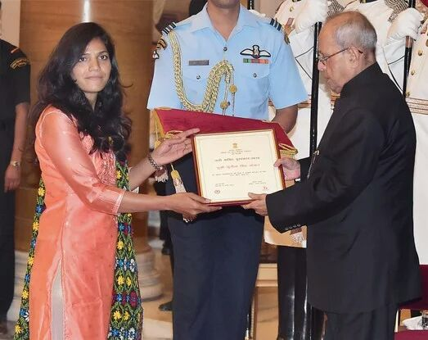
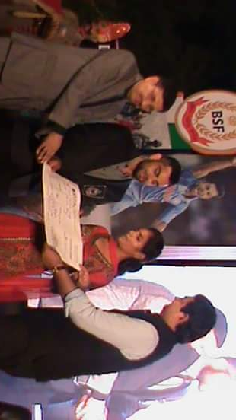
Achievements & Awards

Slide 4
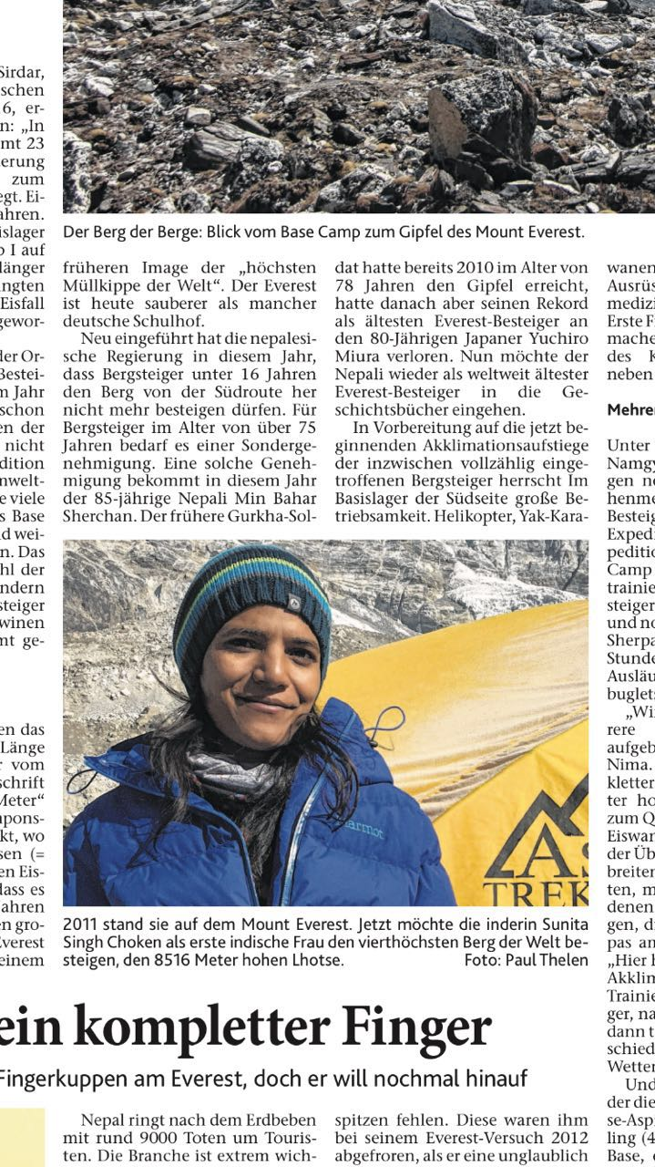
Achievements & Awards:
International Coverage

Slide 5
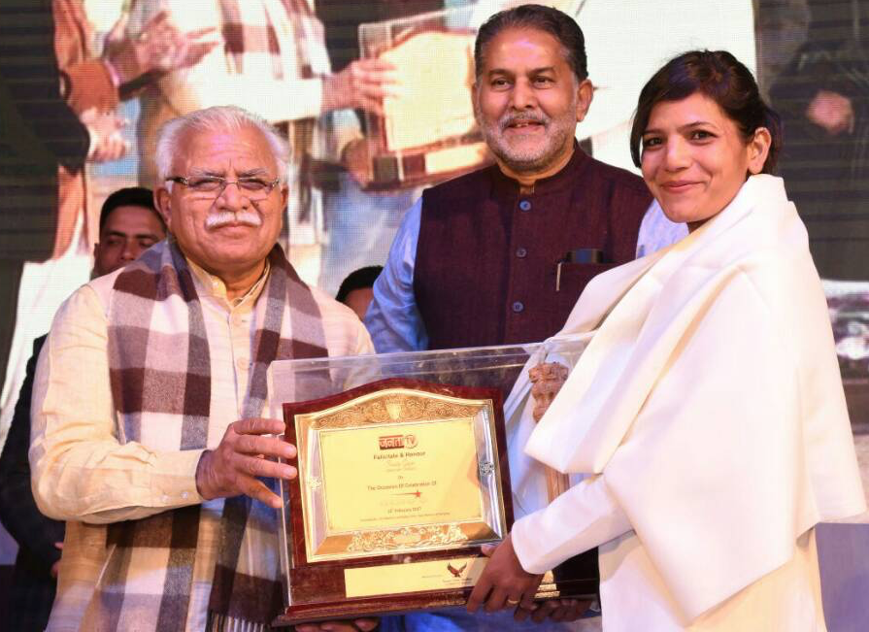
Achievement & Awards :
1. Awarded Nari Shakti Award by the Honorable President of India in 2016.
2.BSF Daughter Award – 2013.
3.Bharat Gorav Award – 2012.
4.Haryana Heroes Award – 2017.
5.Press coverage in Indian, European and Middle Eastern newspapers.

Slide 6
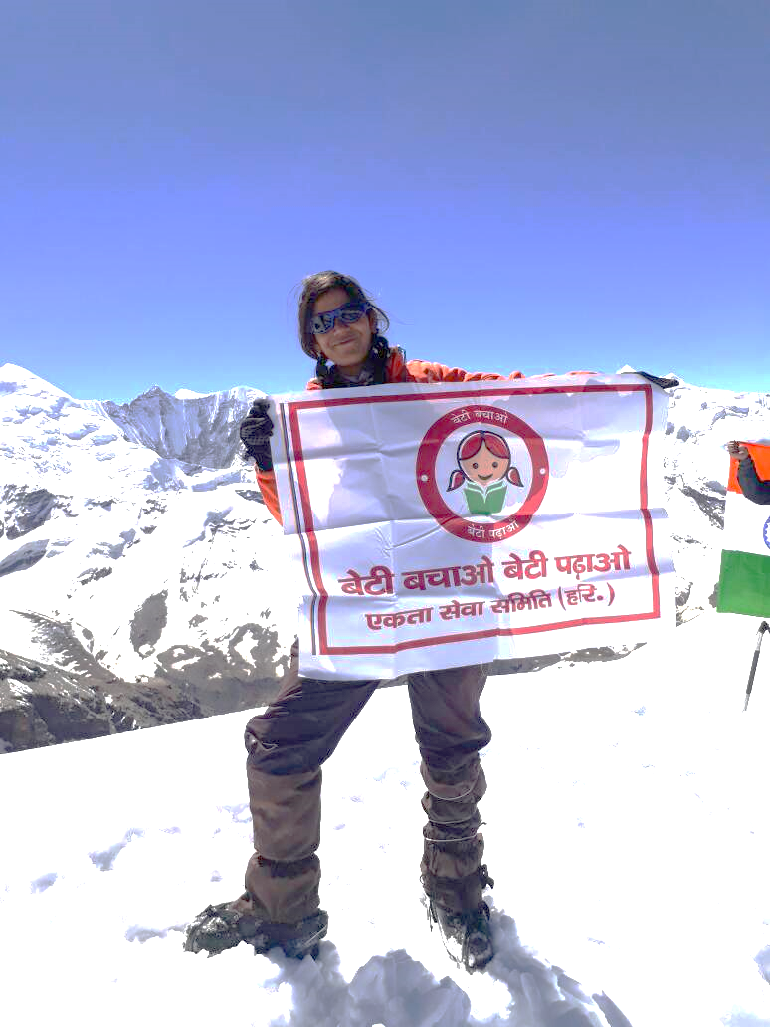
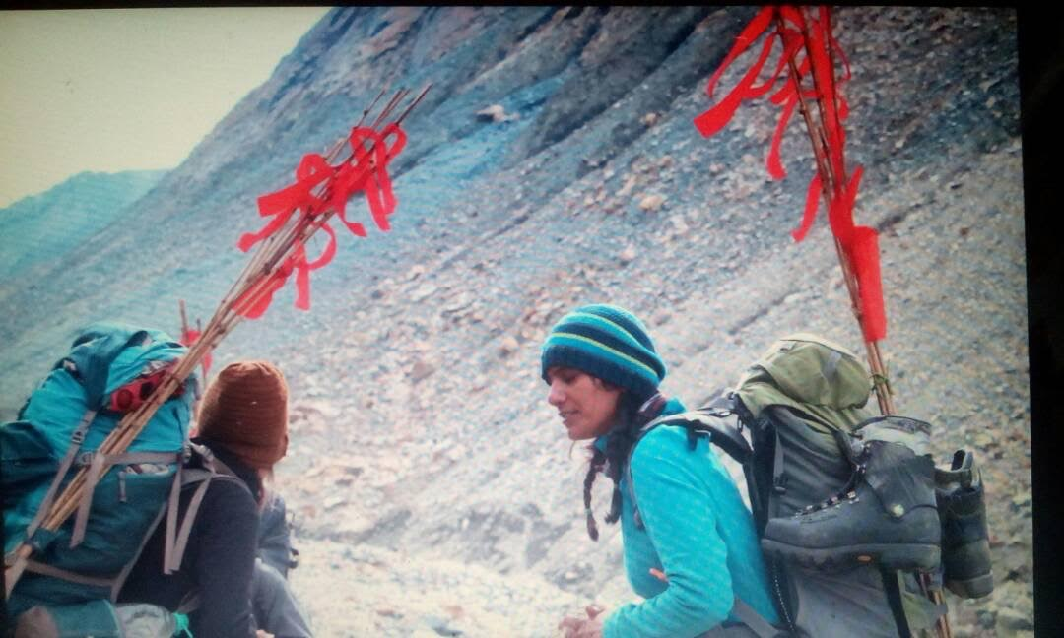
Brand Ambassador of Prime Minister’s “Beti Bachao Beti Padao” Photo by – Staff member [Peak- BETI] Bitmap On the 5th of June she resumed her downward journey. The group stopped at camp 1 to have lunch and continued their descent to the base camp. The entire team was at the base camp except two of the HAFs including her stayed back at camp 1.

Slide 7
Another never before done Expedition.
She is now 1st. Girl in India to cover this route over Cycle (Solo Cycling) and will be eligible for Record making in Limca Book of records.
Daily blogs of travel activity and tree plantation activity posted on Social media by various bloggers/ Followers. https://travelogues.co/2018/08/09/day-24-gujarat-to-nepal-on-cycle-with-rtn-sunita-singh-choken/
She posted videos/ Images of plantation on her blog while she met prominent personalities of Town/City, Rotary Clubs & Rotary Distt. representatives.
Videos and Photos posted on official facebook page of RC Rewari Main & Rotary District – 3011.
https://www.facebook.com/462218487145929/posts/2038707752830320/
https://www.facebook.com/RotaryDistrict3011/
Exchanged the flag of Rotary club of Rewari Main with all the Rotary Clubs on route.

Slide 8
Objective :- Fellowship between Rotary Clubs and Districts.
Rotary Districts & Rotary Clubs associated with us and helping in this initiative are:-
Rotary Districts :-
3060, 3051, 3054, 3040, 3030, 3240, 3261, 3250, 3291, 3292.
Rotary Clubs:-
RC Viraval, RC Bhuj Wallcity, RC Rajkot Greater, RC Rajkot Midtown, RC Halvad, RC Junagarh, RC Jetpur, RC Morbi, RC Gandhidham Midtown, RC, Bachau, RC Ahmedabad Majesty, RC Dahod, RC Godhra, RC Jhabua, RC Jhabua Azad, RC Rajgarh, RC Dhar & Other Rotary Clubs, RC Indore Central & other Rotary Clubs, RC Hatpiplya, RC Itarsi, RC Nagpur, RC Durg Greater, RC Bilaspur, RC Raigarh Steel City, RC Bhilai Greater, RC Raipur Queens, RC Sundargarh, RC Gumla, RC Ranchi, RC Bokaro Midtown Couples, RC Dhanbad, RC Durgapur, RC Amenity Bhardaman, RC Kulti, RC Asansol, RC Raniganj, RC Calcutta Mahanagar, RC Bolpur Rangamati, RC Dhuliyan, RC Malda Central, RC Raiganj, RC Gazole, RC Guskara, RC Siliguri, RC Kalimpong, RC Siliguri Uttorayan, RC Gangtok, RC Kakarvitta, RC Bhadrapur, RC Biratnagar Downtown, RC Birtamode, RC Birtamode Midtown, RC Surunga, RC Damak, RC Urlabari, RC Bardibas, RC Nijgadh, RC Biratnagar Mid Town, RC Biratnagar Down Town, RC Biratnagar, RC Makawanpur, RC Birgunj Metropolis, RC Dharan, RC Dharan Ghopa, RC Itahari, RC Dhulikhel, RC Hetauda, RC Durbarmarg, E-Club of District 3292, RC Satellite Club of Kathmandu West, RC Chandragiri, RC Mount Everest Lalitpur, RC Kathmandu Midtown, RC Kathmandu.

Slide 9
Objective Met:- The Greener Planet (Mission)
Plant 5005 trees Rajsamand (Near Udaipur, Rajasthan) on 27th – 28th. July 2018.
Plant 30-40 Plants daily during her cycling tour, spreading the message that this is the only way to save our plant/ Ecological System and reduce pollution.
Cyclists joined her on route to celebrate/Participate the Green revolution.
Educate children about importance of plants in our lives and motivate them to plant as many trees as
possible.

Slide 10
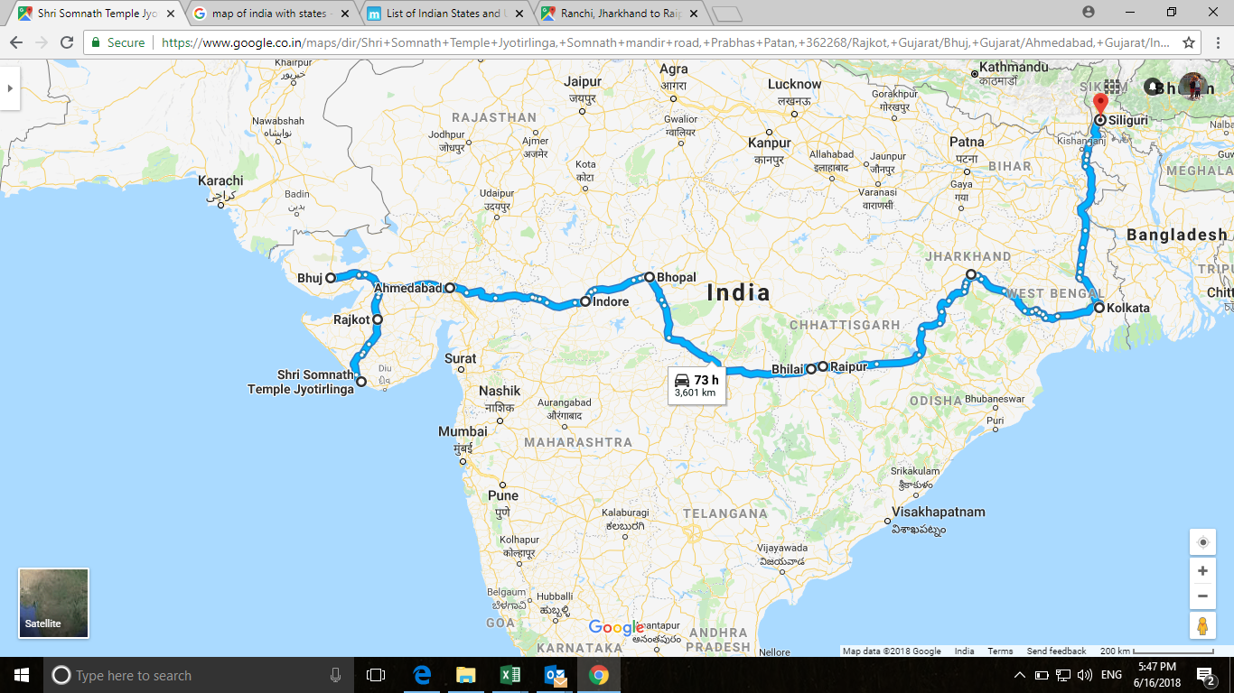
Her Cycling Route – India
Total Distance: 5,000 Km.
Duration: 50 days
Across 7 states in North India
Touching states such as, Gujrat, MP, Orissa, Chattisgarh,Jharkand,West Bengal, Sikkim in India.
Would be eligible for Limca Book of records.
Shall eventually cycle from Somnath Temple to Kathmandu via Sikkim.
Will touch various Rotary Districts 3060, 3051, 3054, 3040, 3030, 3240, 3261, 3250, 3291, 3292 and meet representatives of their clubs to exchange flag of Rotary Club Of Rewari Main.
INDIA

Slide 11
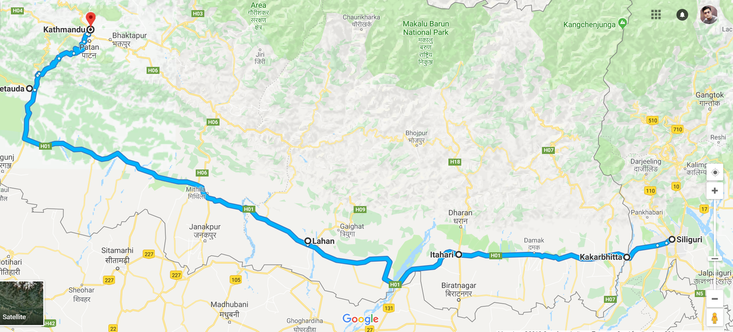
Her Cycling Route – Nepal

Slide 12
Route Plan Till July 28, 2018
Date | Day No. | Day | Start Point | State | End Point / Night Stay | State | KM Travel | Primary Contact For Night Stay / Camp | Rotary Club | Contact # | Stay Yes/No | Distt ID | DG Name
13-Jul-18 |  | Friday | Rewari | Haryana | Rajkot | Gujrat | 0 | Rtn. Yash Rathod, Rtn. Bhavesh Vagde AG, Rtn. Nilesh Sheth 9925110404 | RC Rajkot (Yash Ji) | 9724277777, 9714777077 (Yash) 9824234233 (Bhavesh Ji) | Yes | 3060 | Rtn. Pinky Patel
14-Jul-18 |  | Saturday | Somnath, Viraval | Gujrat | Somnath | Gujrat | 0 | Rtn. Dev Nathwani President Viraval | RC Viraval | 9824222320 | Yes | 3060 | Rtn. Pinky Patel
15-Jul-18 | 1 | Sunday | Somnath Temple | Gujrat | Junagarh | Gujrat | 100 | Rtn. Hitesh Agarwat, RC Prakash Mehta AG Junagarh | RC Junagarh | 9909028930 (Hitesh Ji), 9824239735 | Yes | 3060 | Rtn. Pinky Patel
16-Jul-18 | 2 | Monday | RC Junagarh | Gujrat | Morbi | Gujrat | 164 | Rtn. Divyesh Aghera, Rtn. Bhavesh Vagde AG (9824234233) Rtn. Prakash Doshi Morbi, Rtn. Ajit Sheth Morbi | RC Rajkot , RC Morbi | 9825075874 (Divyesh Ji), 9825053520 (Prakash Ji) , 9825061224 (Ajit Ji) | Yes | 3060 | Rtn. Pinky Patel
17-Jul-18 | 3 | Tuesday | Morbi | Gujrat | Bhuj | Gujrat | 170 | Rtn. Sachin Thacker, Rtn. Thakur Makhijani, Rtn. Amit Chauhan AG Bhuj | RC Bhuj Wallcity, RC Gandhidham | 9825758070 9879743017, 9825442574 (Amit Ji) | Yes | 3054 | Rtn. Neeraj Sogani
18-Jul-18 | 4 | Wednesday | Bhuj | Gujrat | Bachau | Gujrat | 80 | Rtn. Vanraj Singh | RC Bachau | 9825491191 | Yes | 3060 | Rtn. Pinky Patel
19-Jul-18 | 5 | Thursday | Bachau | Gujrat | Halvad | Gujrat | 105 | Rtn. Narbheram Aghara, Rtn. Prashant DGN, | RC Halvad | 9426922055, 9825506111 (Prashant Ji) | Yes | 3060 | Rtn. Pinky Patel
20-Jul-18 | 6 | Friday | Halvad | Gujrat | Ahmedabad | Gujrat | 151 | Rtn. Madhav Kulkarni (Ahmedabad Main) Rtn. Kaushal Shah AG, Rtn. Jignesh Gandhi (Ahmedabad Mygesty) | RC Ahmedabad Main, RC Ahmedabad Majesty | 9724221100 (Madhav Ji) 7016781036 (Kaushal Ji), 9327002923 (Jignesh Ji) | Yes | 3054 | Rtn. Neeraj Sogani
21-Jul-18 | 7 | Saturday | Ahmedabad | Gujrat | Godhra | Gujrat | 130 | Rtn. Niraj Shah (Godhra) | RC Godhra | 8200033429 | Yes | 3040 | Rtn. Gustad Anklesaria
22-Jul-18 | 8 | Sunday | Godhra | Gujrat | With Police Escort Jhabua Via Dohad (70km) NH47 Stay at Dohad for 90 mins max | MP | 114 | Rtn. Chandiprased V Upadhyay, Rtn. Bamaniaji, Rtn. Ramesh Joshi Rtn. Umang Saxena (Jhabua) | RC Dohad RC Jhabua | 9428550035, 7698614886, 7801996747 (Ramesh Ji) 9993816706 (Umang Ji) | Yes | 3040 | Rtn. Gustad Anklesaria
23-Jul-18 | 9 | Monday | Jhabua | MP | Dhar With Police Escorts | MP | 95 | Stay at Dhar Rtn. Sunil Mandlecha - Mohankhera, Rtn. Pankaj | RC Rajgarh | 9425967865, 9893825612, 9425319488 | Yes | 3040 | Rtn. Gustad Anklesaria
24-Jul-18 | 10 | Tuesday | Dhar | MP | Indore With Police Escorts | MP | 75 | Rtn. Ashit Rajkotia, Rtn. Archana Asit Rajkotia | RC Indore Central | 9425053790, 9425054643 | Yes | 3040 | Rtn. Gustad Anklesaria
25-Jul-18 | 11 | Wednesday | Indore | MP | Harda via Khategaon (119) | MP | 157 | Sh. R K Dogne MLA Harda Congress With Gurjar Samaj | NA |  | Yes | NA | NA
26-Jul-18 | 12 | Thursday | Harda | MP | Itarsi | MP | 90 | Train from Itarsi to Nagpur at 02:45 pm Rtn. Prashant Jain, Rtn. Pramod Baveja Rtn. Kapil Bahri | RC Itarsi, RC Nagpur | 9425040170, 9425040030 9372322547 | Train to Nagpur at 02:40 pm | 3040 3030 | Rtn. Gustad Anklesaria Rtn. Rajiv Sharma
27-Jul-18 | 13 & 14 | Friday | Nagpur | Maharashtra | Udaipur | MP | 0 | By Flight, No Cycling, Rtn. Kapil will drop airport. | RC Nagpur | 9372322547 | Yes | 3030 | Rtn. Rajiv Sharma
28-Jul-18 | 13 & 14 | Saturday | Udaipur | MP | Nagpur | Maharashtra | 0 | Udaipur to Nagpur by Flight, Rtn. Kapil will receive. | RC Nagpur | 9372322547 | Yes | 3030 | Rtn. Rajiv Sharma

Slide 13
Route Plan Till Aug 15, 2018
Date | Day No. | Day | Start Point | State | End Point / Night Stay | State | KM Travel | Primary Contact For Night Stay / Camp | Rotary Club | Contact # | Stay Yes/No | Distt ID | DG Name
29-Jul-18 | 13 & 14 | Sunday | Nagpur | Maharashtra | Itarsi | MP | 0 | Early morning train from Nagpur to reach Itarsi 02:45 pm Rtn. Prashant Jain, Rtn. Pramod Baveja Rtn. Kapil Bahri | RC Itarsi, RC Nagpur | 9425040170, 9425040030 9372322547 | Train to Itarsi at 09:15 am IST | 3040 3030 | Rtn. Gustad Anklesaria Rtn. Rajiv Sharma
30-Jul-18 | 15 | Monday | Itarsi | MP | Multai | MP | 145 | Sh. Bhushan, Ref Rtn. Prashant Jain (With Police Escorts) | RC Itarsi | 9179968088 | Yes | 3040 | Rtn. Gustad Anklesaria
31-Jul-18 | 16 | Tuesday | Multai | MP | Nagpur | Maharashtra | 140 | Rtn. Kapil Bahri (With Police Escorts) | RC Nagpur | 9372322547 | Yes | 3030 | Rtn. Rajiv Sharma
1-Aug-18 | 17 | Wednesday | Nagpur | Maharashtra | Deori via Bhandara | Maharashtra | 150 | Sh. Kamaljit Singh 8668879179 Sh. Pappu Bhatia Ji Ref. Rtn. Brijesh Patel Ji | NA | 9340010611 | No | 0 | NA
2-Aug-18 | 18 | Thursday | Deori | Maharashtra | Durg | Chhattisgarh | 110 | Sunita will stay at her friend's home | NA | NA | Yes | 0 | NA
3-Aug-18 | 19 | Friday | Durg | Chhattisgarh | Raipur | Chhattisgarh | 50 | Rtn. Nidhi Thakkar | RC Raipur Queens | 9669510008 | Yes | 3261 | Rtn. Dr. Nikhilesh M Trivedi
4-Aug-18 | 20 | Saturday | Raipur | Chhattisgarh | Basna | Chhattisgarh | 155 | Inlaws of Rtn. Sushil Ramdass Aggarwal | RC Raigarh Steel City | 9755150000 (Sushil Ji) | Yes | 3261 | Rtn. Dr. Nikhilesh M Trivedi
5-Aug-18 | 21 | Sunday | Basna | Chhattisgarh | Raigarh | Chhattisgarh | 135 | Rtn. Deepak Aggarwal, Rtn. Sushil Ramdass Aggarwal | RC Raigarh Steel City | 7999485210, 9755150000 (Sushil Ji) | Yes | 3261 | Rtn. Dr. Nikhilesh M Trivedi
6-Aug-18 | 22 | Monday | Raigarh | Chhattisgarh | Sundargarh | Orissa | 125 | Rtn. Dr. Chirabratta Dutta | RC Sundargarh | 9437083161 | Yes | 3261 | Rtn. Dr. Nikhilesh M Trivedi
7-Aug-18 | 23 | Tuesday | Sundargarh | Orissa | Jashpur Nagar | Chhattisgarh | 140 | Rtn. Sandeep Gupta' Sister Residence | RC Gumla | 7033543569, 9431195569 | Yes | 3250 | Rtn. Kumar Prasad Sinha
8-Aug-18 | 24 | Wednesday | Jashpur Nagar | Chhattisgarh | Gumla | Jharkhand | 60 | Rtn. Sandeep Gupta | RC Gumla | 7033543569, 9431195569 | Yes | 3250 | Rtn. Kumar Prasad Sinha
9-Aug-18 | 25 | Thursday | Gumla | Jharkhand | Ranchi | Jharkhand | 100 | Rtn. Sandeep Munjal, Rtn Rajesh Shahdeo, Rtn Harminder Singh | RC Ranchi | 9431114629, 9973769040, 9835342202 9431101442 | Yes | 3250 | Rtn. Kumar Prasad Sinha
10-Aug-18 | 26 | Friday | Ranchi | Jharkhand | Dhanbad Via Bokaro | Jharkhand | 160 | Rtn. Dr. Manish Kumar, Rtn. Anju, Rtn. Rohit Lala, Rtn. Bharat Narula, Rtn. Sajan Kapoor, Rtn. Sushant Sharma | RC Dhanbad, RC Bokaro Midtown Couples | 9430358833, 9835197001, 9709304334, 9431160917 | Yes | 3250 | Rtn. Kumar Prasad Sinha
11-Aug-18 | 27 | Saturday | Dhanbad | Jharkhand | Kulti 51km - Barakar - Asansol 70km - Raniganj 85 - Durgapur | West Bengal | 120 | Rtn. Mrs. Siuli Mukherjee, Rtn. Smaeer Choudhary | RC Kulti, RC Asansol, RC Durgapur | 9933399235 | Yes | 3240 | Rtn. Dr. Sayantan Gupta Rtn. Subhasish Chatterjee DGN
12-Aug-18 | 28 | Sunday | Durgapur | Jharkhand | Bardhaman | West Bengal | 80 | Rtn. Paban Bhagat | RC Amenity Bardhaman | 9733041920, 9333649718 | Yes | 3240 | Rtn. Dr. Sayantan Gupta Rtn. Subhasish Chatterjee DGN
13-Aug-18 | 29 | Monday | Bardhaman | West Bengal | Kolkata | West Bengal | 115 | Rtn. Chitra Agarwal | RC Calcutta Mahanagar | 8013564679 | Yes | 3291 | Rtn. Mukul Sinha
14-Aug-18 | 30 | Tuesday | Kolkata | West Bengal | Kolkata | West Bengal | 0 | Flight to Delhi | NA | NA | NA | NA | NA
15-Aug-18 | 31 | Wednesday | Kolkata | West Bengal | Delhi | Delhi | 0 | Lunch with President of India | NA | NA | NA | NA | NA

Slide 14
Route Plan Till Sep 02, 2018
Date | Day No. | Day | Start Point | State | End Point / Night Stay | State | KM Travel | Primary Contact For Night Stay / Camp | Rotary Club | Contact # | Stay Yes/No | Distt ID | DG Name
16-Aug-18 | 32 | Thursday | Rewari | Haryana | Delhi | Delhi | 0 | Flight to Kolkata, Stay at Sudarshan's Home | NA | NA | NA | NA | NA
17-Aug-18 | 33 | Friday | Kolkata | West Bengal | Bolpur | West Bengal | 170 | Rtn. Saptarishi Das Baptoo | RC Bolpur | 9593837080, 9436947463 | Yes | 3240 | Rtn. Dr. Sayantan Gupta Rtn. Subhasish Chatterjee (Raja) DGN
18-Aug-18 | 34 | Saturday | Bolpur | West Bengal | Rampurhat | West Bengal | 80 | Dr. Sumanta | RC Durgapur | 9547418166 | Yes | 3240 | Rtn. Dr. Sayantan Gupta Rtn. Subhasish Chatterjee (Raja) DGN
19-Aug-18 | 35 | Sunday | Rampurhat | West Bengal | Dhuliyan | West Bengal | 95 | Rtn. Mehboob Alam | RC Dhuliyan | 9593405976 | Yes | 3240 | Rtn. Dr. Sayantan Gupta
20-Aug-18 | 36 | Monday | Dhuliyan | West Bengal | Malda | West Bengal | 95 | Rtn. Rajesh Gupta , Rtn. Manoj Jain (PP), Rtn. Kishore Choudhary | RC Malda Central | 9434065325, 7908592354 (Rajesh G) 7585952609, 9933052609 (Manoj G) | Yes | 3240 | Rtn. Dr. Sayantan Gupta
21-Aug-18 | 37 | Tuesday | Malda | West Bengal | Raiganj Via Gazole | West Bengal | 70 | Rtn.PP Partha Pratim Bhattacherjee | RC Raiganj, RC Gazole | 9434054445 | Yes | 3240 | Rtn. Dr. Sayantan Gupta
22-Aug-18 | 38 | Wednesday | Raiganj | West Bengal | Islampur Via Surjapur Toll plaza | West Bengal | 120 | PWD Circuit House booked by Rtn. Sushil Kumar Dubey | RC Siliguri West Bengal | 9434044980 | Yes | 3240 | Rtn. Dr. Sayantan Gupta Rtn. Subhasish Chatterjee DGN
23-Aug-18 | 39 | Thursday | Islampur | West Bengal | Silliguri | West Bengal | 85 | Rtn. Sushil Kumar Dubey | RC Siliguri West Bengal | 9434044980 | Yes | 3240 | Rtn. Dr. Sayantan Gupta Rtn. Subhasish Chatterjee DGN
24-Aug-18 | 40 | Friday | Silliguri | West Bengal | Sikkam Manipal Inst. Of Tech. Majitar | West Bengal | 80 | Rtn. Sanjogita Subba AG, Rtn. Bibeth Verma, Rtn. Prakash Gupta | RC Kalingpong | 9832033410, 9434053619 9933801446, 9733801000 | Yes | 3240 | Rtn. Dr. Sayantan Gupta Rtn. Subhasish Chatterjee DGN
25-Aug-18 | 41 | Saturday | Majitar | West Bengal | Gangtok - Back to Rangpo | Sikkam | 90 | Rtn. Prakash Mundra | RC Gangtok | 9832352126, 9434447955 | Yes | 3240 | Rtn. Dr. Sayantan Gupta Rtn. Subhasish Chatterjee DGN
26-Aug-18 | 42 | Sunday | Rangpo | Sikkam | Silliguri | West Bengal | 70 | Rtn. Sushil Kumar Dubey, Rtn. Sajjan Reteria | RC Siliguri, RC Siliguri Uttorayan | 9434044980, 9434006786 | Yes | 3240 | Rtn. Dr. Sayantan Gupta Rtn. Subhasish Chatterjee DGN
27-Aug-18 | 43 | Monday | Silliguri | West Bengal | Itihari Via Kakarbhitta, Mechinagar | Nepal | 125 | Rtn. Robin, Rtn. Sujan Pradhan, Rtn. Umesh Clubs on way RC Kakarvitta, RC Birtamode, RC Surunga, RC Damak, RC Urlabari Go to Dharan by car from Itihari | RC Dharan, RC Kakarbhitta | 977- 9852047136 977-9852662265 | Yes | 3291 | Rtn. Chintamani Bhattarai
28-Aug-18 | 44 | Tuesday | Itihari | Nepal | Lahan | Nepal | 110 | Mr. Hamal Pandav (Ref. Robin Ji) | NA | 9779851156150 | Yes | 3291 | Rtn. Chintamani Bhattarai
29-Aug-18 | 45 | Wednesday | Lahan | Nepal | Chandranigahpur via Bardibas | Nepal | 147 | Rtn. Dipender, Gautam hotel | RC Bardibas | 9779854027013 | Yes | 3291 | Rtn. Chintamani Bhattarai
30-Aug-18 | 46 | Thursday | Chandranigahpur | Nepal | Hetauda | Nepal | 78 | Nijgadh (Rtn. Ashish Tamang +977 985-5044165) - Pathliaya - Birjung - Rtn. Komar at Hetauda | RC Makawanpur | 977-9851000173 | Yes | 3291 | Rtn. Chintamani Bhattarai
31-Aug-18 | 47 | Friday | Hetauda | Nepal | Simlang | Nepal | 83 | Rtn. Nugal | RC Darbarmarg | 977-9851039703 | Yes | 3291 | Rtn. Chintamani Bhattarai
1-Sep-18 | 48 | Saturday | Simlang | Nepal | Kathmandu Via Testung | Nepal | 55 | Rtn. Nugal | RC Darbarmarg | 977-9851039703 | Yes | 3291 | Rtn. Chintamani Bhattarai
2-Sep-18 | 49 | Sunday |  |  |  |  |  | FACILITATION CEREMONY AT KATHMANDU

Slide 15
Links to Blogs and Facebook Page
Introduction:-
https://travelogues.co/2018/07/14/somnath-to-nepal-5000-km-solo-cycling-expedition-by-sunita-singh-chocken-jenny-chocken-15th-july-23rd-august/
https://www.tripoto.com/trip/gujarat-to-nepal-on-cycle-with-sunita-singh-chocken-alais-jenny-chocken-5b4c6fd2924dd
Day-1 https://travelogues.co/solo-cycling-by-sunita-singh-chocken-jenny-chocken-from-somnath-temple-to-nepal-5000-km/
Day -2 https://travelogues.co/2018/07/16/day-2-gujarat-to-nepal-on-cycle-with-sunita-singh-chocken/
Day -3 https://travelogues.co/2018/07/18/day-3-gujarat-to-nepal-on-cycle-with-sunita-singh-chocken/
Day -4 https://travelogues.co/2018/07/19/day-4-gujarat-to-nepal-on-cycle-with-sunita-singh-chocken/
Day -5 https://travelogues.co/2018/07/20/day-4-gujarat-to-nepal-on-cycle-with-sunita-singh-chocken-2/
Day-6 https://travelogues.co/2018/07/21/day-6-gujarat-to-nepal-on-cycle-with-sunita-singh-choken/
Day -7 https://travelogues.co/2018/07/23/day-7-gujarat-to-nepal-on-cycle-with-sunita-singh-choken/
Day -8 https://travelogues.co/2018/07/23/day-8-gujarat-to-nepal-on-cycle-with-sunita-singh-choken/
Day -9 https://travelogues.co/2018/07/24/day-9-gujarat-to-nepal-on-cycle-with-sunita-singh-choken/
Day -10 https://travelogues.co/2018/07/25/day-10-gujarat-to-nepal-on-cycle-with-sunita-singh-choken/
Day -11 https://travelogues.co/2018/07/29/day-11-gujarat-to-nepal-on-cycle-with-sunita-singh-choken/
Day-12 https://travelogues.co/2018/07/29/day-12-gujarat-to-nepal-on-cycle-with-sunita-singh-choken/
Day – 13 & 14 https://travelogues.co/2018/07/30/day-1314-gujarat-to-nepal-on-cycle-with-sunita-singh-choken-planted-5000-saplings-at-udaipur/
Day – 15 https://travelogues.co/2018/07/31/day-15-gujarat-to-nepal-on-cycle-with-sunita-singh-choken/
Day – 16 https://travelogues.co/2018/08/01/day-16-gujarat-to-nepal-on-cycle-with-sunita-singh-choken/
Day – 17 https://travelogues.co/2018/08/02/day-17-gujarat-to-nepal-on-cycle-with-sunita-singh-choken/
Day – 18 https://travelogues.co/2018/08/04/day-18-gujarat-to-nepal-on-cycle-with-sunita-singh-choken/
Day – 19 & 20 https://travelogues.co/2018/08/06/day-19-20-gujarat-to-nepal-on-cycle-with-rtn-sunita-singh-choken/

Slide 16
Links to Blogs and Facebook Page
Day – 21 https://travelogues.co/2018/08/07/day-21-gujarat-to-nepal-on-cycle-with-rtn-sunita-singh-choken/
Day – 22 & 23 https://travelogues.co/2018/08/08/day-22-23-gujarat-to-nepal-on-cycle-with-rtn-sunita-singh-choken/
Day – 24 https://travelogues.co/2018/08/09/day-24-gujarat-to-nepal-on-cycle-with-rtn-sunita-singh-choken/
Day – 25 & 26 https://travelogues.co/2018/08/11/day-25-26-gujarat-to-nepal-on-cycle-with-rtn-sunita-singh-choken/
Day – 27 https://travelogues.co/2018/08/12/day-27-gujarat-to-nepal-on-cycle-with-rtn-sunita-singh-choken/
Day – 28 https://travelogues.co/2018/08/15/day-28-gujarat-to-nepal-on-cycle-with-rtn-sunita-singh-choken/
Rtn. Sunita Singh Choken (Rotary Club of Rewari Main) at Rastrapati Bhawan for Lunch with His Excellency Sh. Ram Nath Kovind Ji. https://travelogues.co/2018/08/18/sunita-in-delhi-and-calcutta-15th-and-16th-august/
Day – 30 https://travelogues.co/2018/08/20/day-30-gujarat-to-nepal-on-cycle-with-rtn-sunita-singh-choken/
Day – 31 – 32 https://travelogues.co/2018/08/21/day-31-and-32-gujarat-to-nepal-on-cycle-with-rtn-sunita-singh-choken/
Day – 33 – 34 https://travelogues.co/2018/08/23/day-33-gujarat-to-nepal-on-cycle-with-rtn-sunita-singh-choken/
Day – 35 – 36 https://travelogues.co/2018/08/24/day-35-and-36-gujarat-to-nepal-on-cycle-with-rtn-sunita-singh-choken/
Day – 37 – 38 https://travelogues.co/2018/08/26/day-37-and-38-gujarat-to-nepal-on-cycle-with-rtn-sunita-singh-choken/
Day – 39 https://travelogues.co/2018/08/27/day-39-gujarat-to-nepal-on-cycle-with-rtn-sunita-singh-choken/
Day – 40 https://travelogues.co/2018/08/28/day-40-gujarat-to-nepal-on-cycle-with-rtn-sunita-singh-choken/
Day – 41 https://travelogues.co/2018/08/29/day-41-gujarat-to-nepal-on-cycle-with-rtn-sunita-singh-choken/
Day – 42 https://travelogues.co/2018/08/30/day-42-gujarat-to-nepal-on-cycle-with-rtn-sunita-singh-choken/
Day – 43-44 https://travelogues.co/2018/09/01/day-43-44-gujarat-to-nepal-on-cycle-with-rtn-sunita-singh-choken/

Slide 17
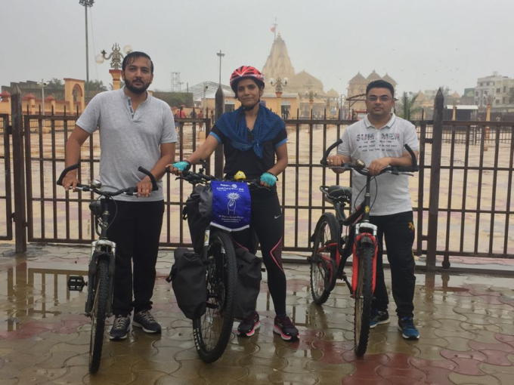
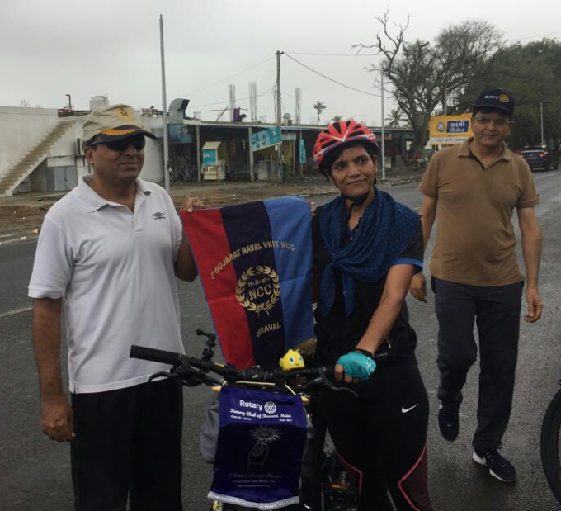
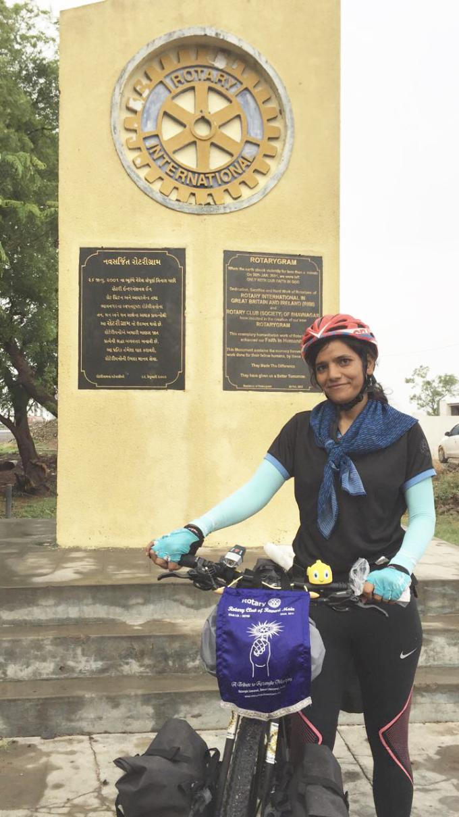
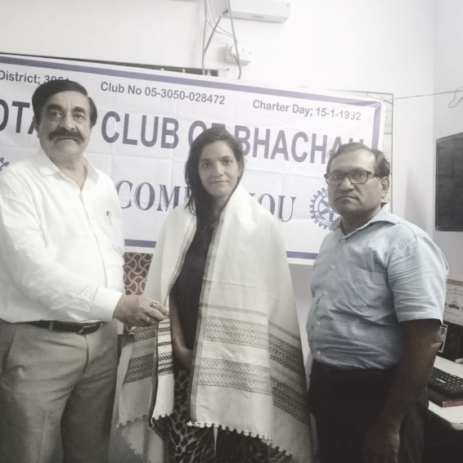
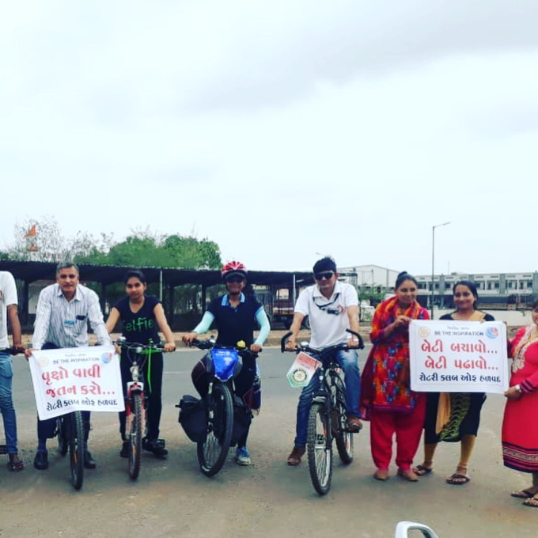
Memorable Pictures – Somnath Mandir

Slide 18
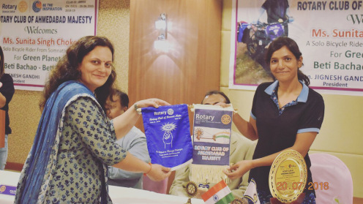
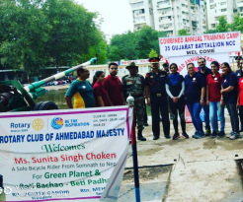
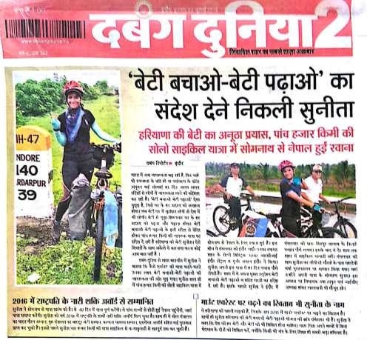
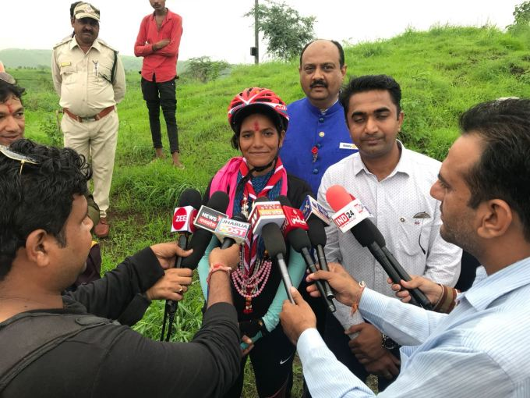
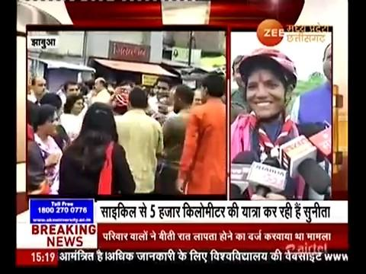
Memorable Pictures – Ahmedabad , Indore

Slide 19
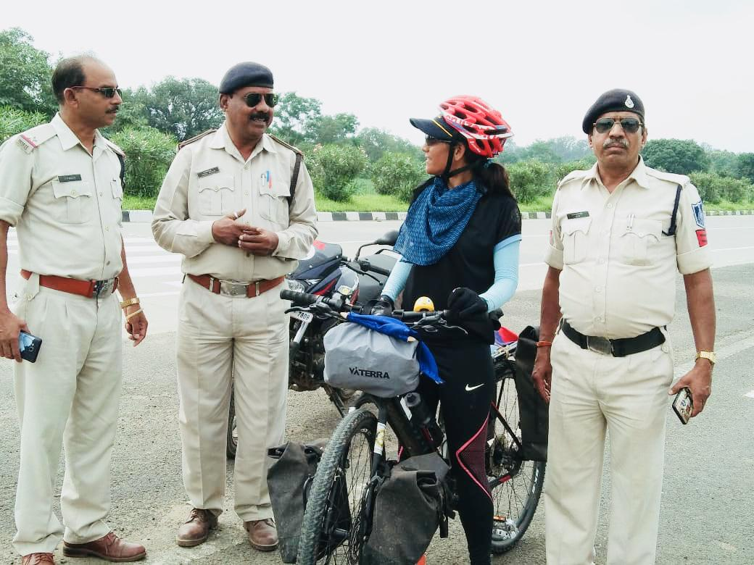
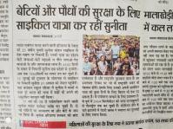
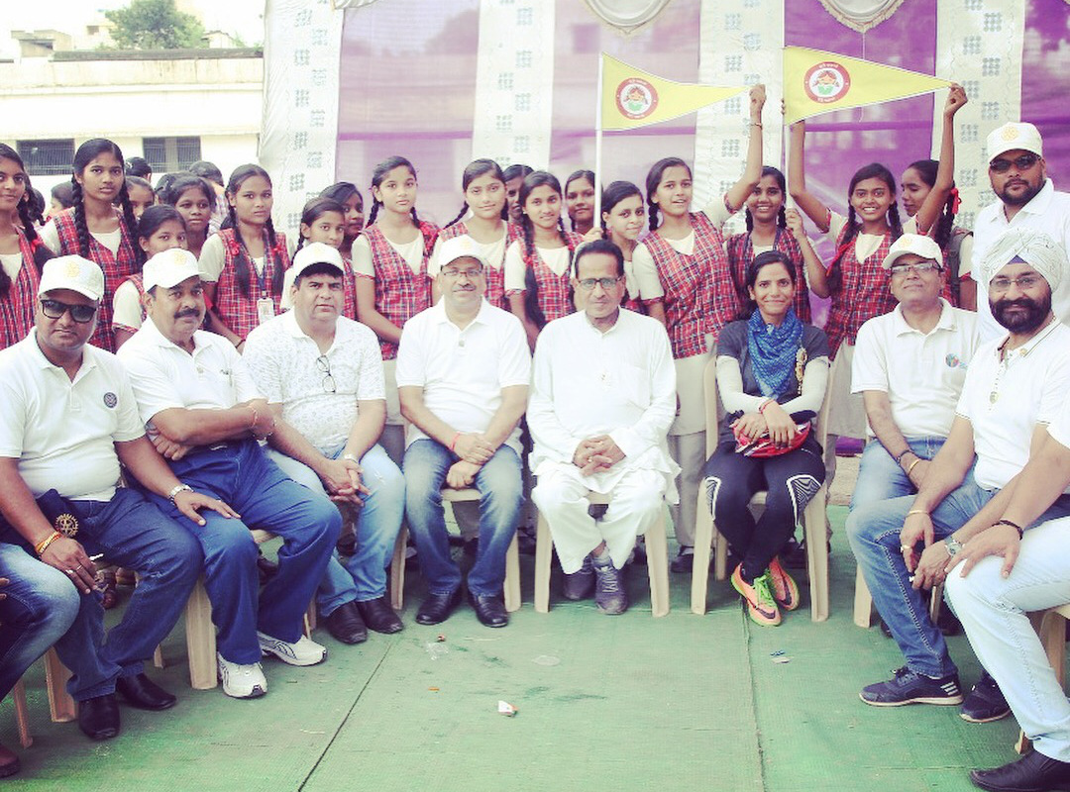
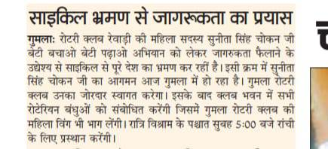
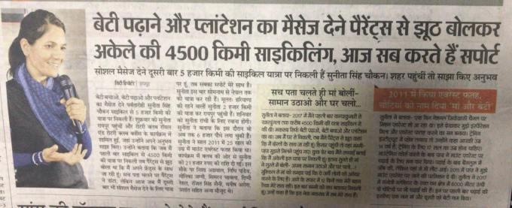
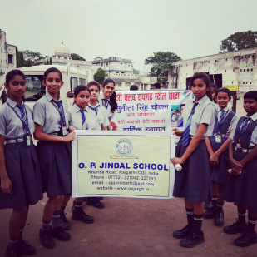
Memorable Pictures - Gumla

Slide 20
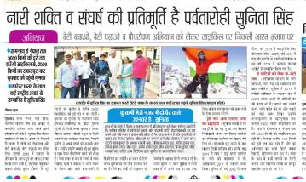
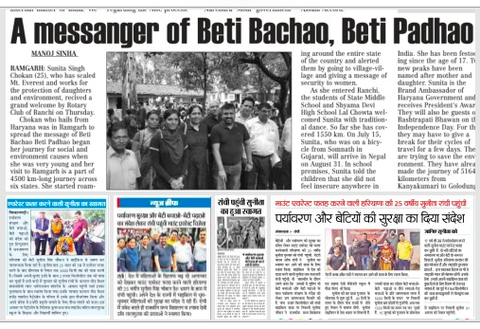
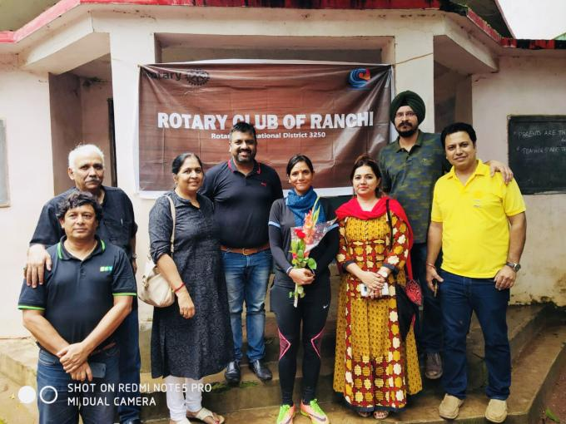
Memorable Pictures - Ranchi

Slide 21
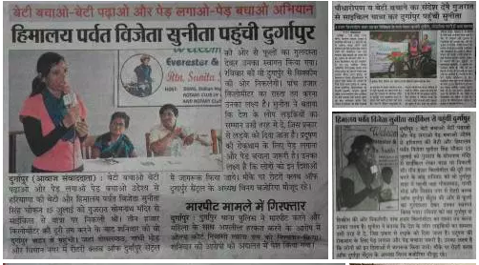
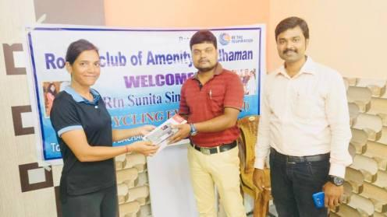
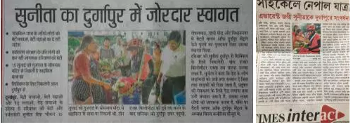
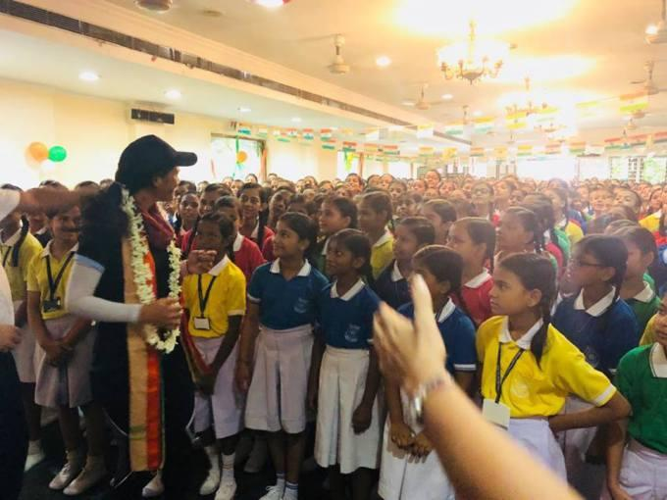
Memorable Pictures - Durgapur

Slide 22
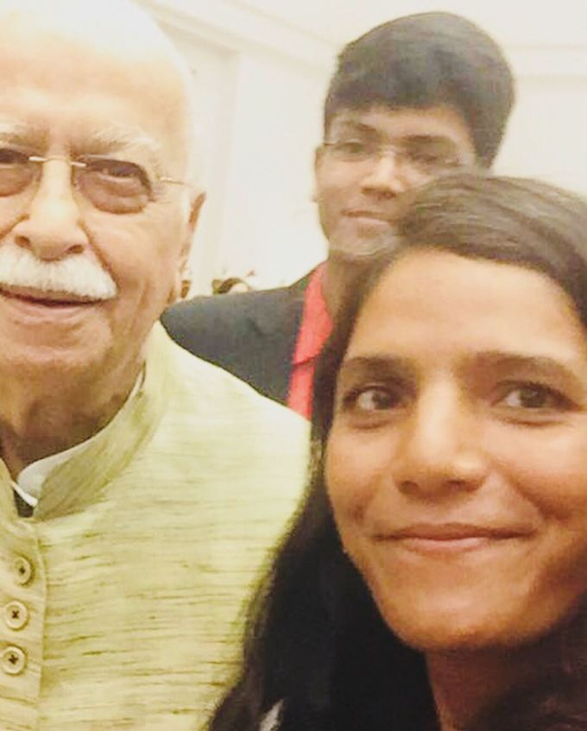
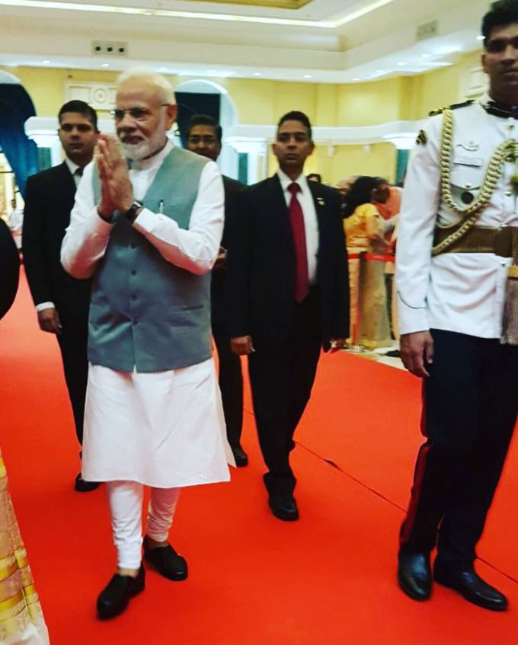
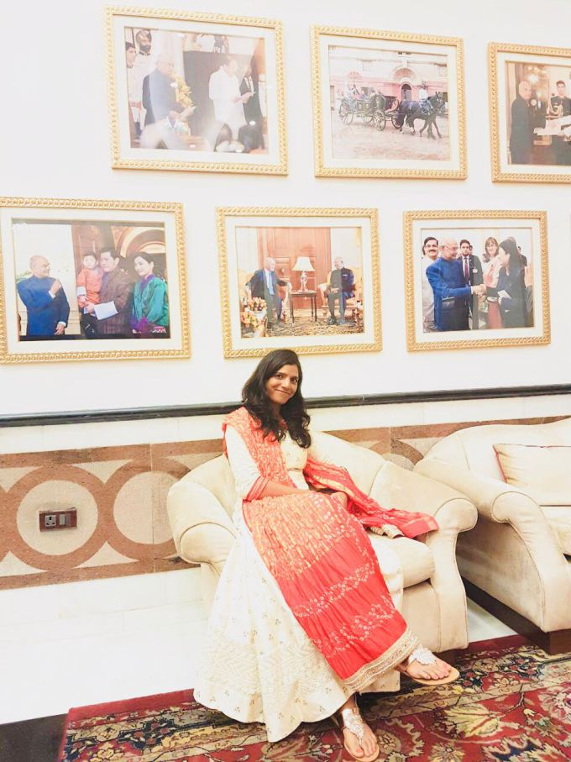
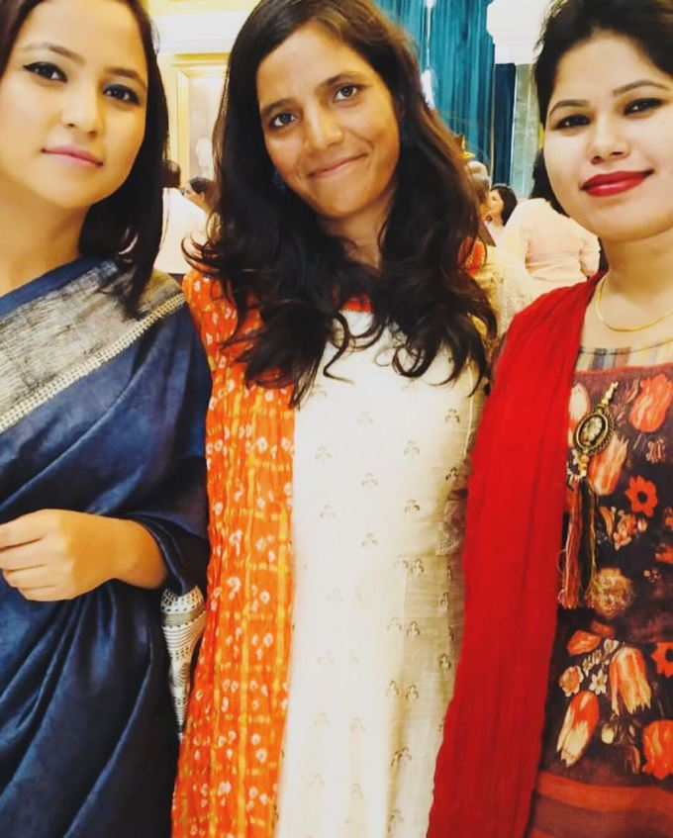
Memorable Pictures – President’s House

Slide 23
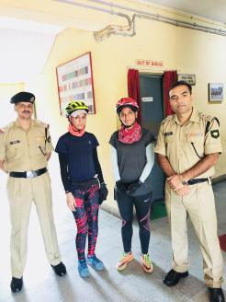
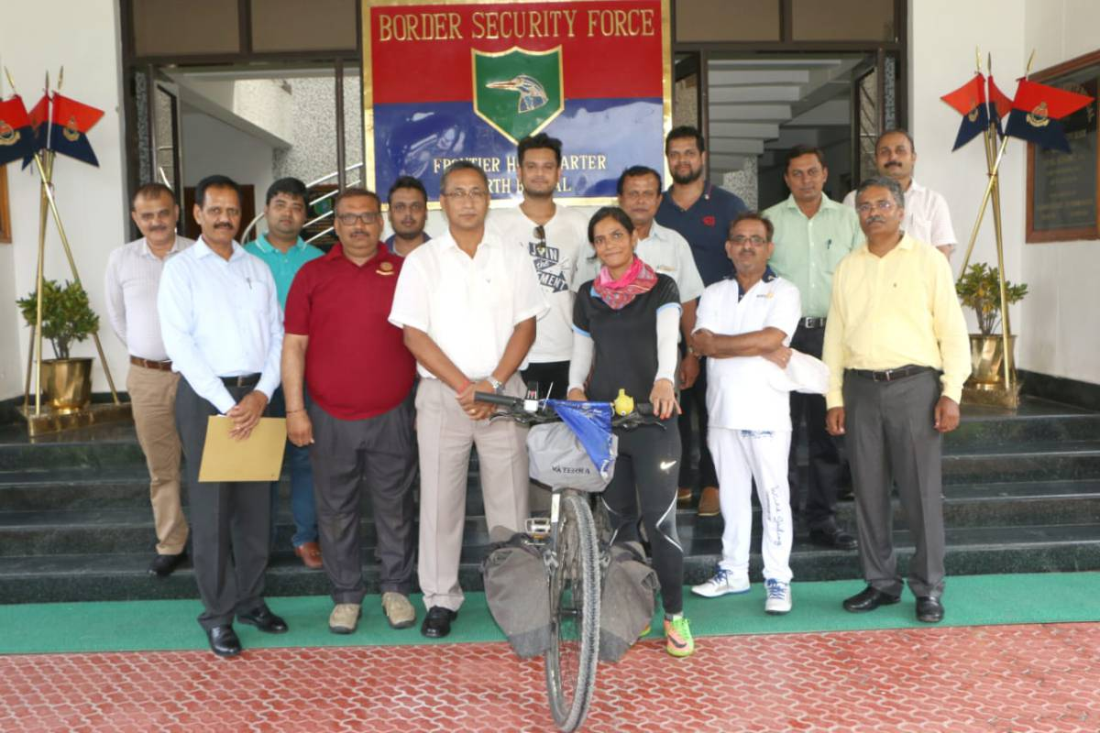
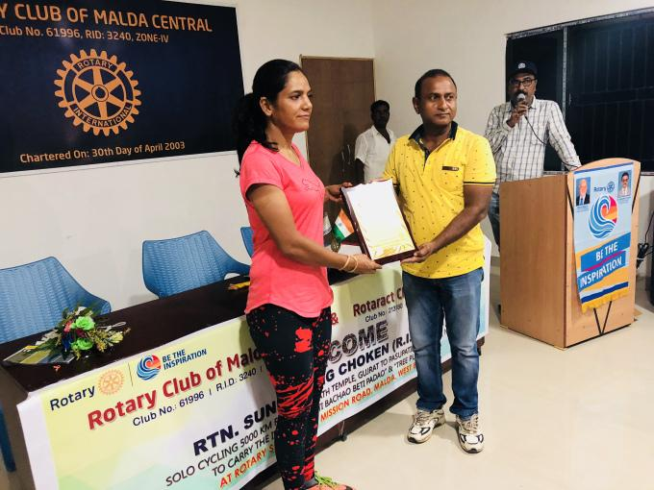
Memorable Pictures - Silliguri

Slide 24
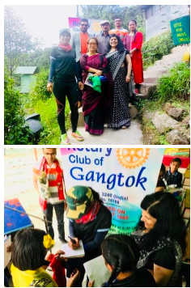
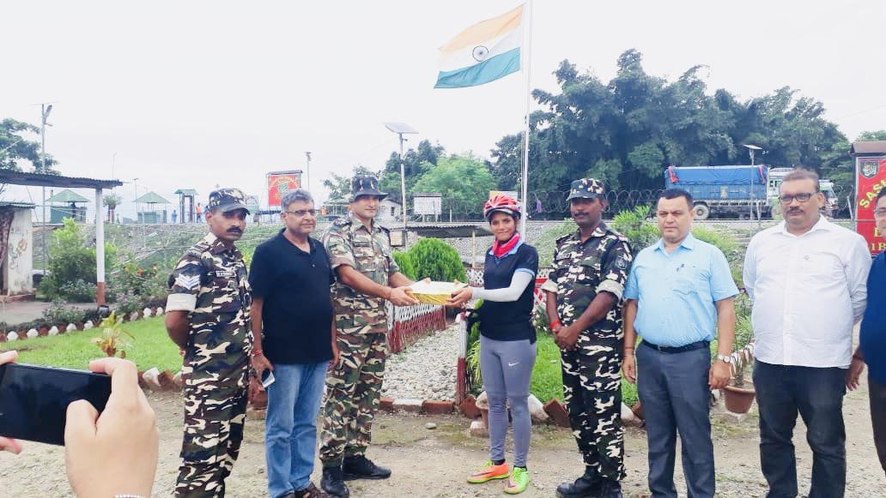
Memorable Pictures – Crossing the Border

Slide 25
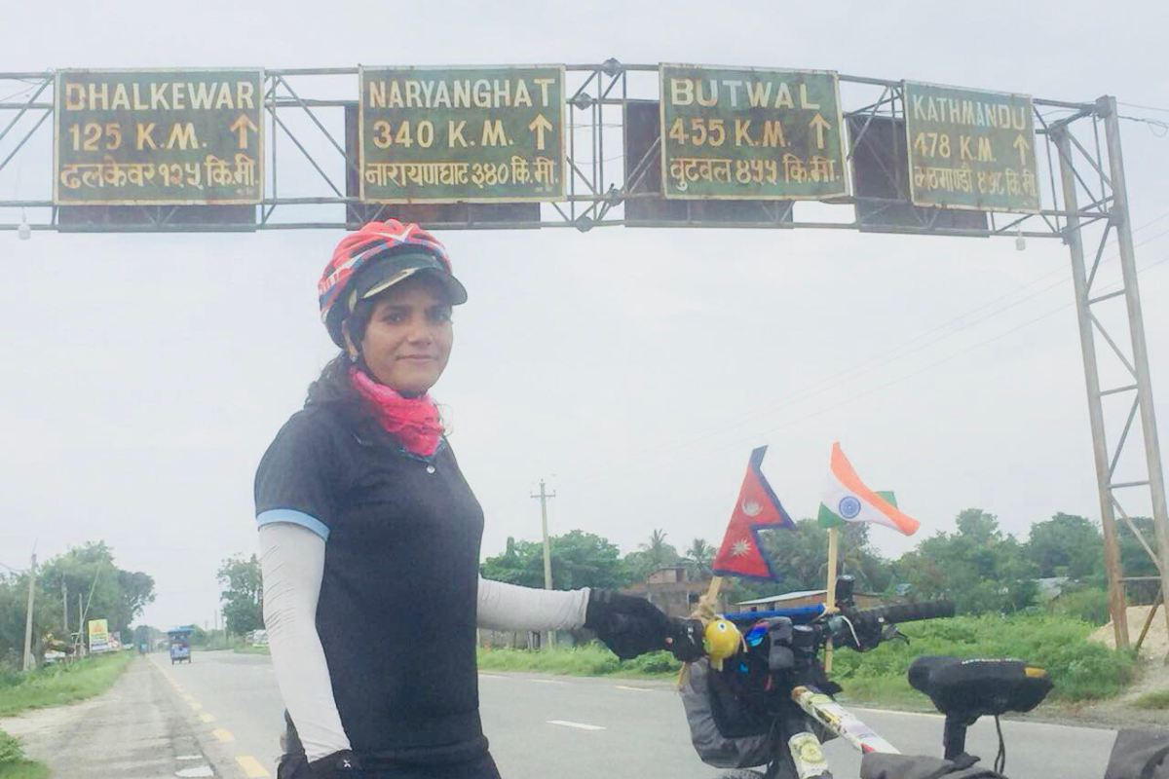
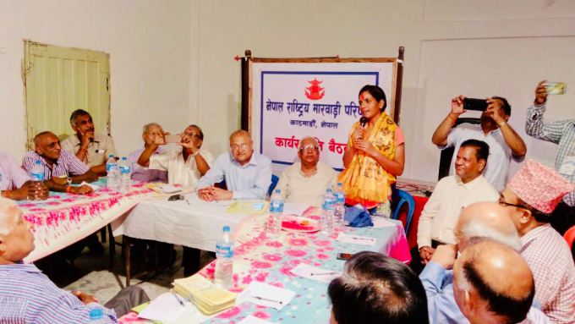
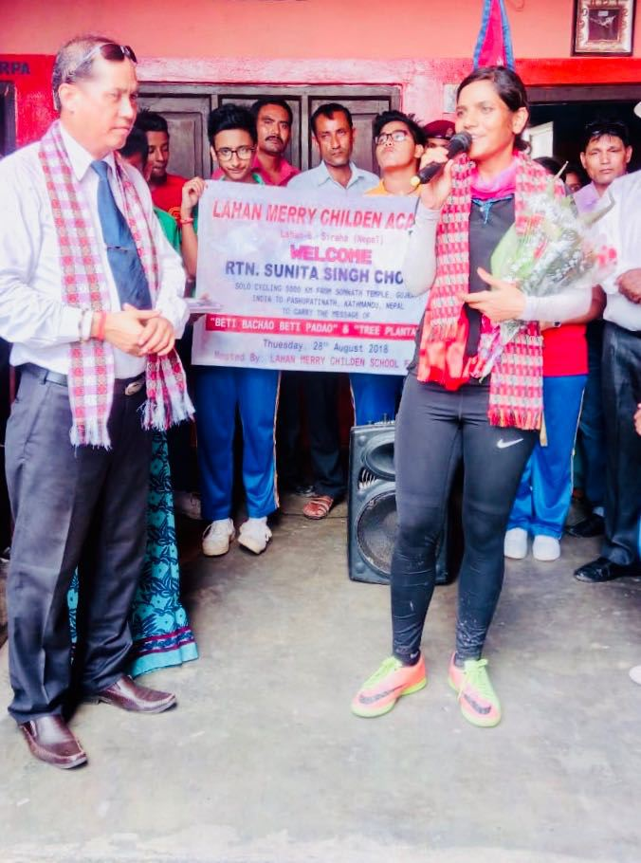
Memorable Pictures - Nepal

Slide 26
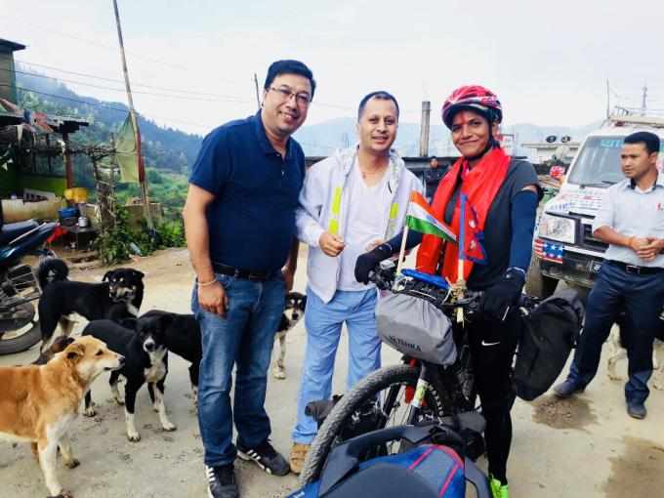
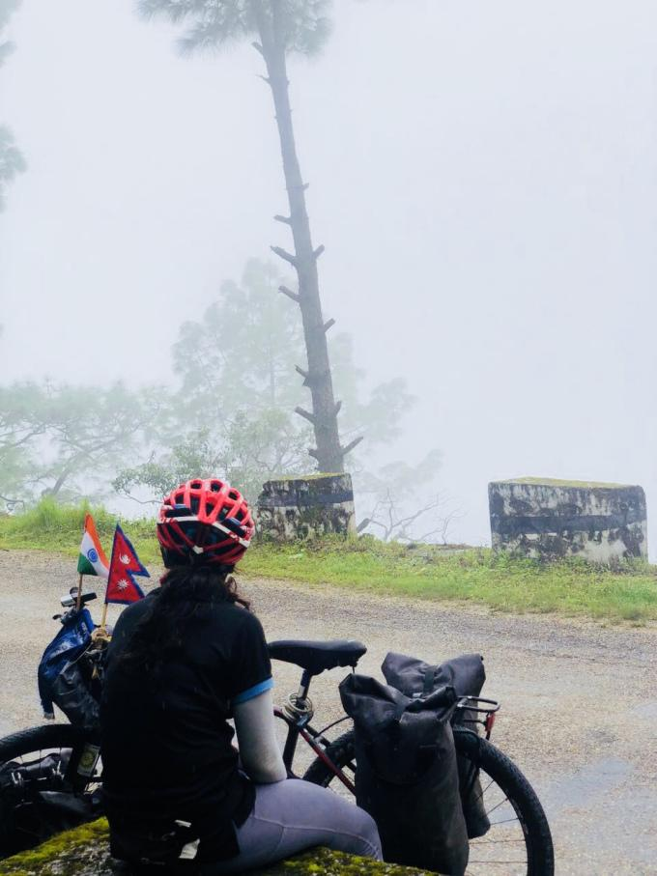
Memorable Pictures - Nepal

Slide 27
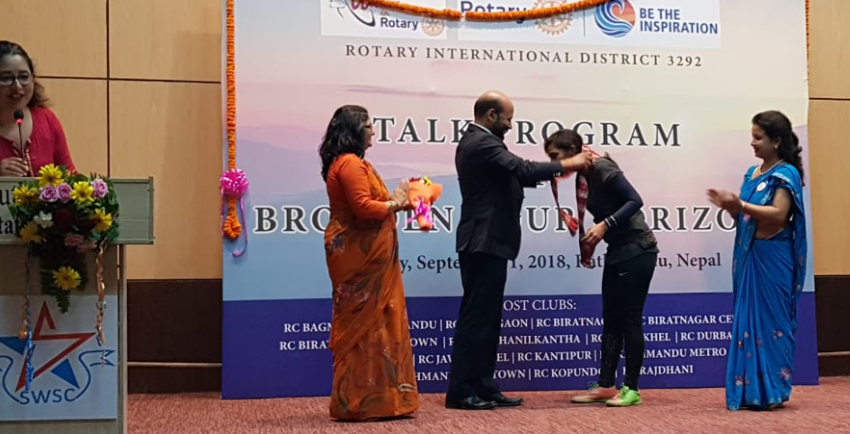
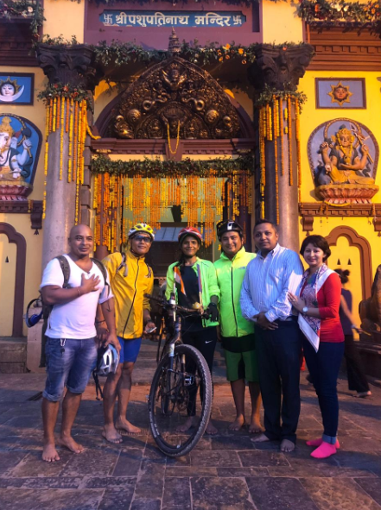
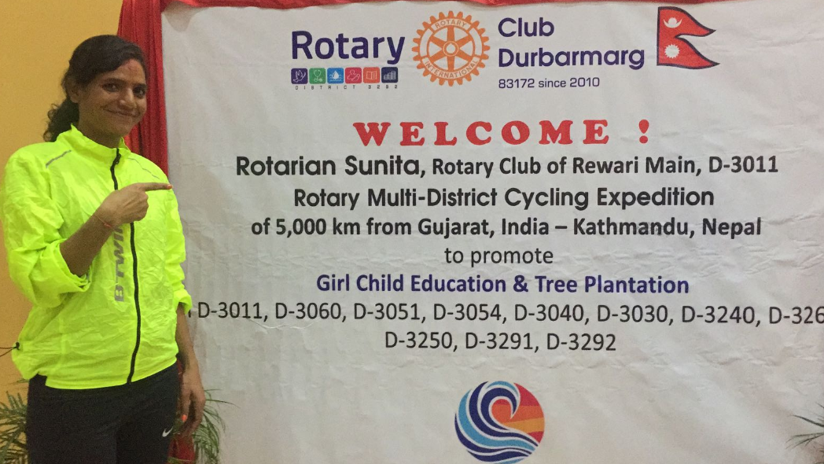
Memorable Pictures – Pashupatinath Mandir

Slide 28
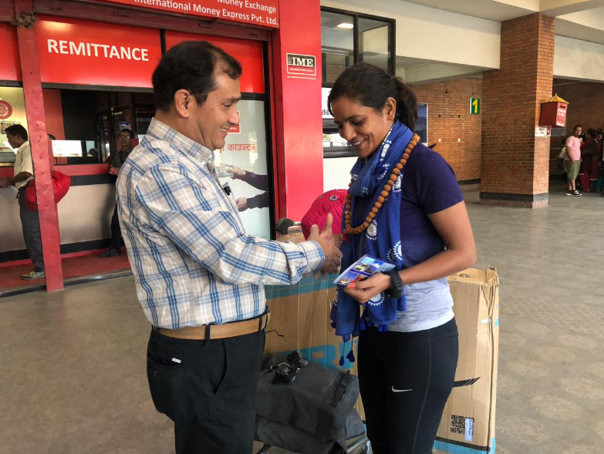
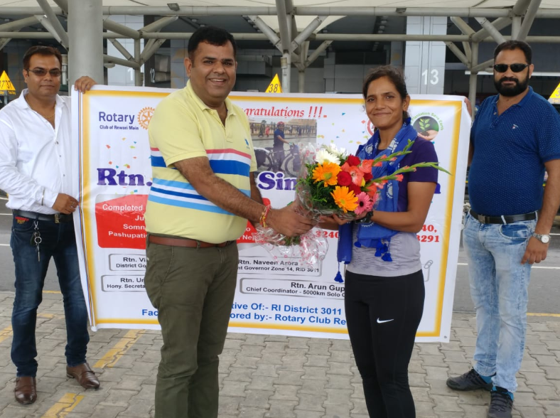
Memorable Pictures – Back to Home

Slide 29
Thanks Rtn. Arun Gupta Chief Coordinator – Unity in Rotary Showcase (5000km Solo Cycling Expedition) President Elect. Rotary Club of Rewari Main, Distt: 3011 Mob:- 9215224720

